Slide 1

Project Title -Seasonal Agriculture Performance Analysis
[Student Name-Naraharisetti Venkata Apoorva
College Name-Seshadri Rao Gudlavalleru Engineering College]
AICTE STU ID :STU64391d6a138531681464682

Slide 2

PROBLEM STATEMENT
Agricultural activities are influenced by seasonal variations in environmental conditions, farming practices, resource availability and market conditions. As a result, agricultural performance may differ from one season to another. However, raw agricultural data does not clearly explain how agricultural performance changes across seasons or what patterns can be observed in different seasonal conditions. The problem is to analyze the given agricultural dataset and investigate seasonal differences in agricultural performance by identifying meaningful patterns, trends, relationships and variations within the available data.

Slide 3
Project Description
Seasonal Agriculture Performance Analysis is a data analytics project that analyzes agricultural data across different seasons, crops, regions, irrigation methods, environmental conditions, resource usage, and economic factors.
The project focuses on identifying:
Seasonal patterns and variations in agricultural performance.
Differences in crop yield and production.
Seasonal profitability and economic outcomes.
Relationships between environmental conditions and agricultural performance.
Resource usage and irrigation performance.
Important correlations and meaningful insights.
The analysis uses data cleaning, statistical analysis, visualization, correlation analysis, and seasonal comparisons to generate evidence-based insights and recommendations for better agricultural planning.

Slide 4
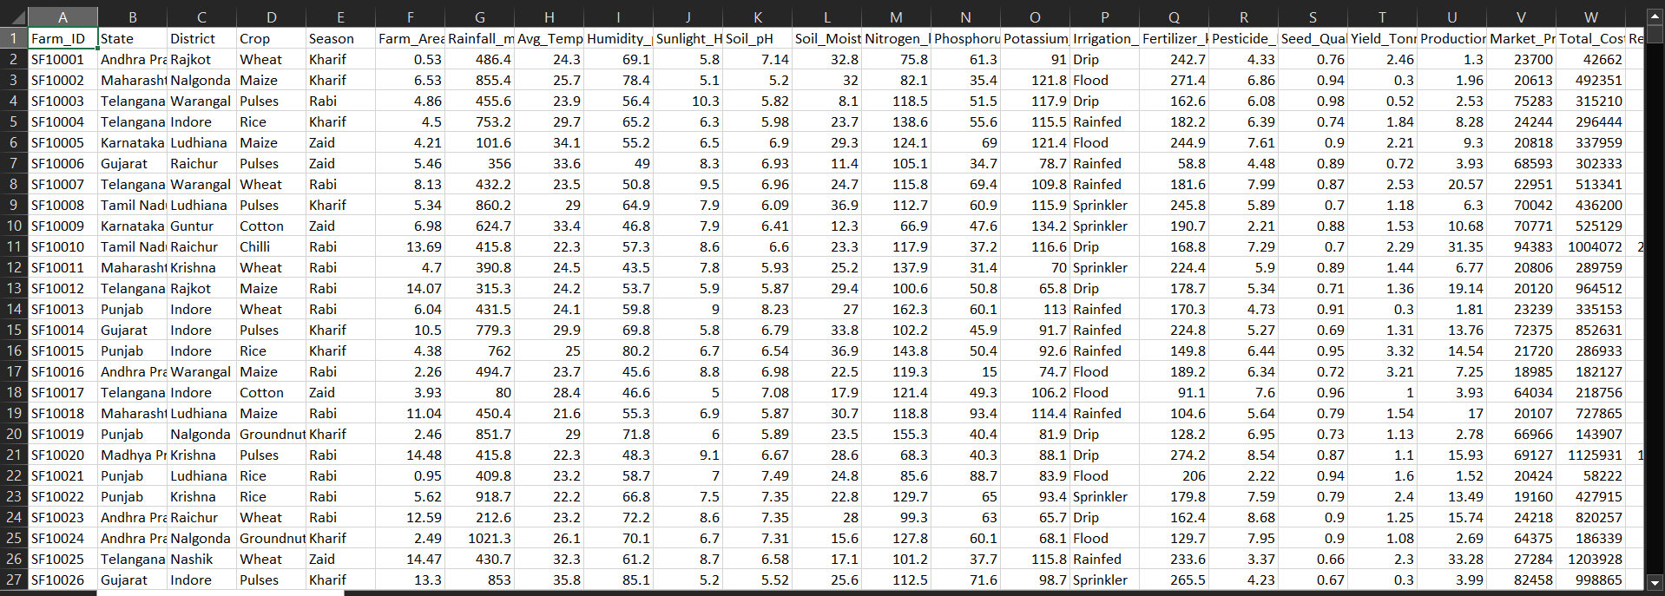
RAW DATASET

Slide 5

WHO ARE THE END USERS?
The end users are people and organizations who can use the project findings to support better agricultural planning and decision-making.
Then list:
Farmers – for better crop, season, and irrigation decisions
Agricultural Planners – for seasonal planning
Agricultural Researchers – for studying agricultural patterns
Government Agricultural Departments – for planning and decision-making
Agribusiness Organizations – for understanding crop and market performance

Slide 6

Technology Used
The project was developed using Python and data analysis and visualization tools in Google Colab.
Technologies:
Python: Programming Language Pandas: Data Analysis NumPy: Numerical Computing Matplotlib: Data Visualization Seaborn: Statistical Visualization Google Colab: Development Platform

Slide 7
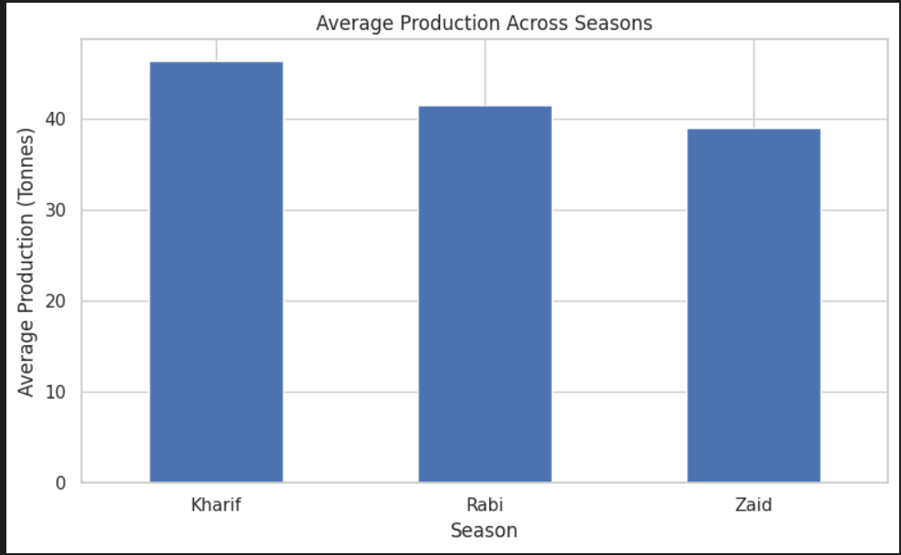
RESULTS
Plot title: Season vs Yield Kharif recorded the highest average yield, while Zaid recorded the lowest.

Slide 8
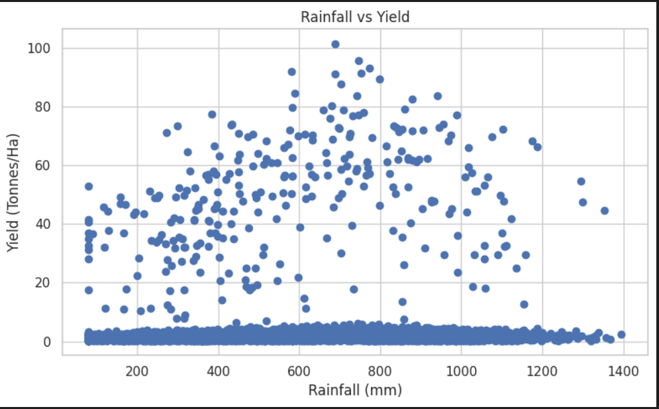
RESULTS
Plot title: Rainfall vs Yield Rainfall showed a very weak relationship with yield.

Slide 9
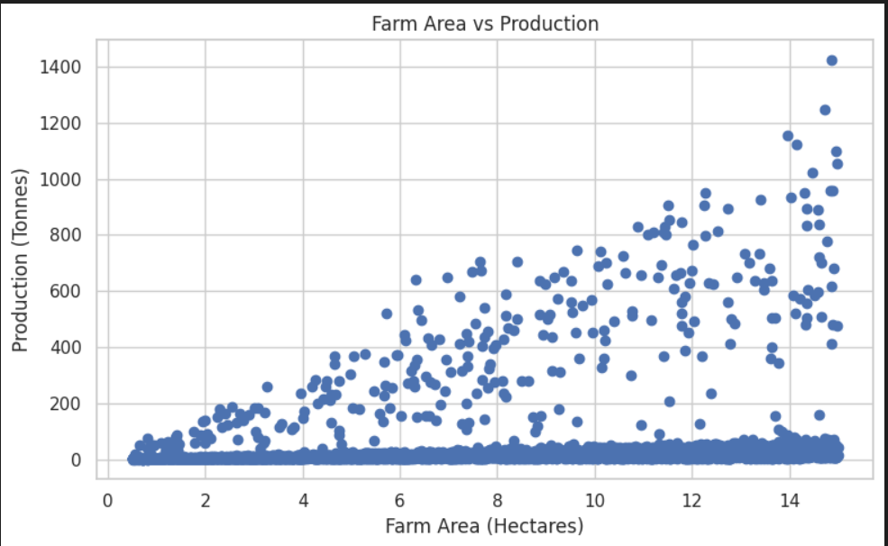
RESULTS
Plot title: Farm Area vs Production
Larger farm areas generally showed higher production.

Slide 10
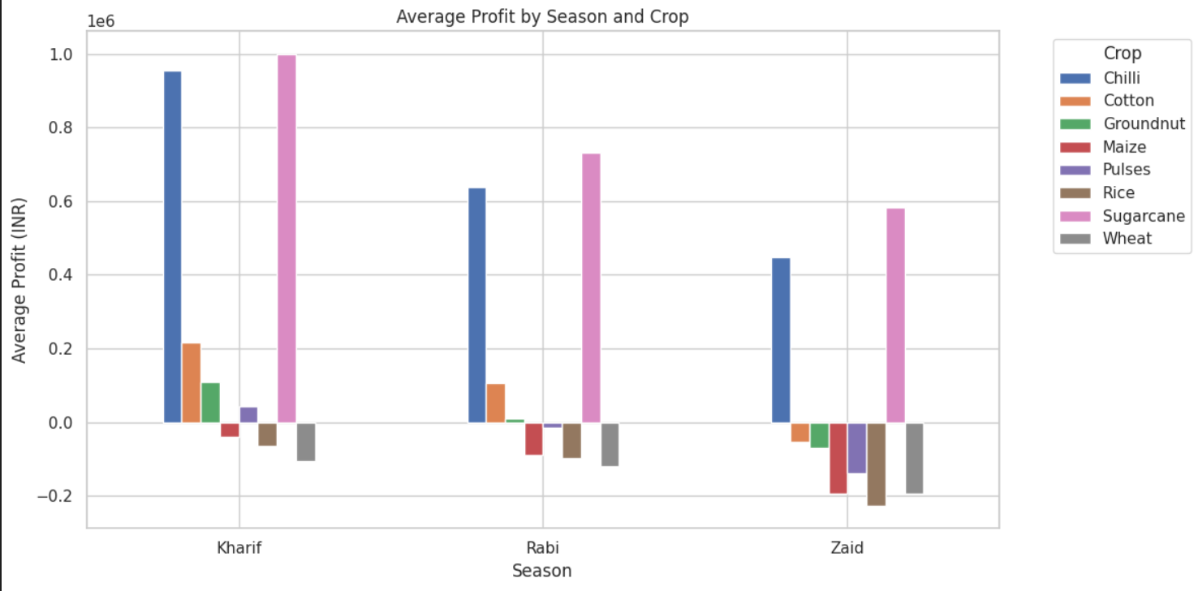
RESULTS
Plot title: Season, Crop and Profit
Sugarcane and Chilli generated the highest profits in the Kharif and Rabi seasons, whereas Sugarcane remained the most profitable crop in Zaid.

Slide 11
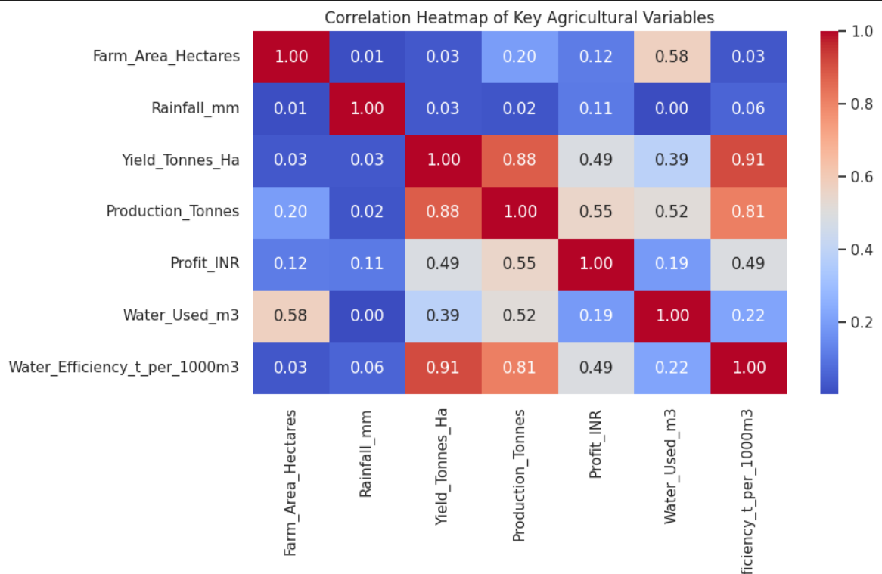
RESULTS
Plot title: Correlation Heatmap
Yield showed a strong relationship with water efficiency and production.

Slide 12
Future scope
Develop a Power BI dashboard for interactive analysis.
Include more years and larger agricultural datasets.
Apply machine learning to predict yield and profit.
Add real-time weather and market-price data.
Provide crop and irrigation recommendations.

Slide 13
GitHub Link
https://github.com/apoorva-venkata/Seasonal_Agriculture_Performance_Analysis.git

Slide 14
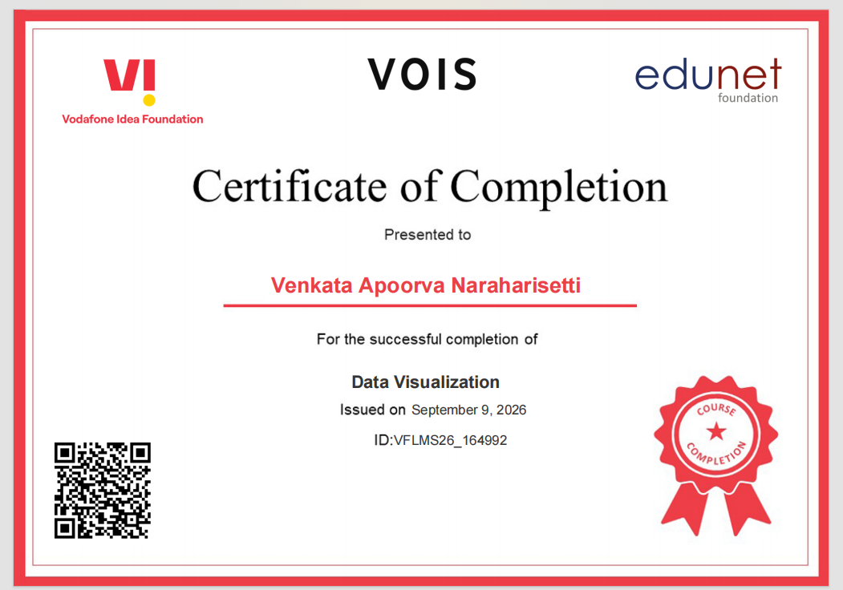
VOIS Course completion certificate - Course name- Data Visualization

Slide 15
Thank you
.
.

